Slide 1

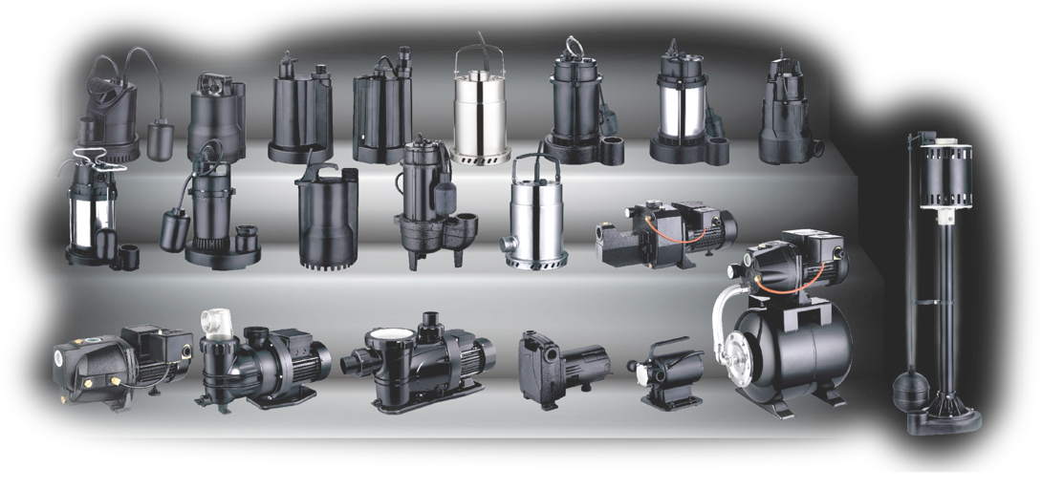

1 Applewood Crescent, Unit 8, Vaughan, ON L4K 4K1
Ph.: 1-888-538-0082
Email: pumps@hena.ca
www.leogroup.cn
Rev. 01.11.2023

Slide 2
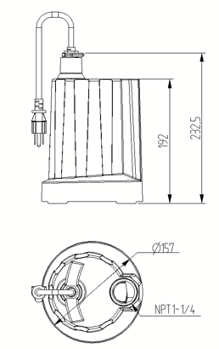
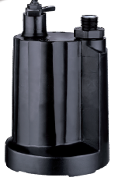

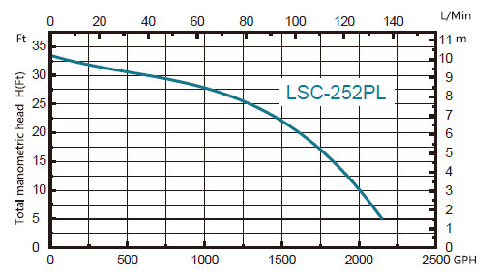
Model #LSC-252PL
1/3 HP Submersible Utility Pump
Inlet | Diameter 14.4 inches
Discharge | NH 3/4
Pump Cover | PA66-GF25
Motor Housing | ZL104+DMC
Pump Body | PP-GF30
Switch Type | /
Impeller | PA6-GF25
Seal Design | Framework oil seal
Seal Material | NBR
Oil Filled Motor | Yes
Power Cord | SJTW 18AWG 10ft
Net Weight (lbs) | 8.2
Gross Weight (lbs) | 9.5
Package Size(in) | 7.9*7*11
Expected Life Cycle | 4000 Hours
Motor Wires | Aluminium wire
Self-Priming | /
Certification | UL
Features & Benefits:
Continuous duty and easy access handle for portability.
Corrosion-resistant, reinforced thermoplastic construction.
Bottom suction design filters debris and removes water down to ¼” from surface.
Built-in automatic thermal overload protector motor.
¾” NPT discharge, 1 ¼” adapter included.
Top discharge design.
10ft power cord.
1 year warranty.
Model | HP | Voltage | AMP | Discharge NPT(In) | GPH of water @ Total Ft. of Head |  |  |  |  | Max.Head Ft
 |  |  |  |  | 5 ft | 10 ft | 15 ft | 20 ft | 25 ft
LSC-252PL | 1/3 | 115 | 4 | 1-1/4 | 2110 | 2000 | 1850 | 1650 | 1300 | 33.5

Slide 3
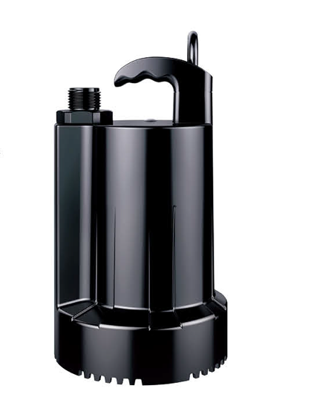
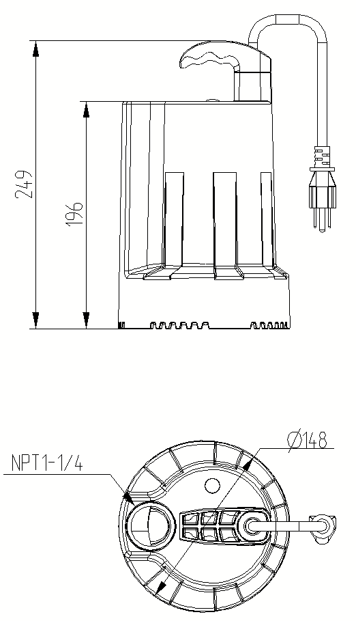
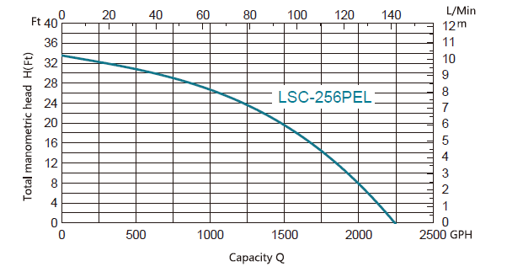
Model #LSC-256PEL
1/3 HP Submersible Automatic Utility Pump
Inlet | Diameter 14.4 inches
Discharge | NH3/4
Pump Cover | PA66-GF25
Motor Housing | ZL104+DMC
Pump Body | PP-GF30
Switch Type | /
Impeller | PA6-GF25
Seal Design | Framework oil seal
Seal Material | NBR
Oil Filled Motor | Yes
Power Cord | SJTW 18AWG 10ft
Net Weight (lbs) | 9.2
Gross Weight (lbs) | 10.2
Package Size(in) | 8.0*7.2*12.4
Expected Life Cycle | 4000 Hours
Motor Wires | Aluminium wire
Self-Priming | /
Certification | UL
Features & Benefits:
Automatically turns on when 1 ½” of water is detected; turns off when water level fall below ¼”.
Corrosion-resistant, reinforced thermoplastic construction.
Bottom suction design filters debris and removes water down to ¼” from surface.
Permanent split capacitor motor and built-in automatic thermal overload protector.
1” NPT discharge, ¾” adapter included.
10ft power cord.
2-year warranty.
Model | HP | Voltage | AMP | Discharge NPT(In) | GPH of water @ Total Ft. of Head |  |  |  |  | Max.Head Ft
 |  |  |  |  | 5 ft | 10 ft | 15 ft | 20 ft | 25 ft
LSC256PEL | 1/3 | 115 | 4 | 1 | 2110 | 1900 | 1700 | 1490 | 1110 | 33.5

Slide 4
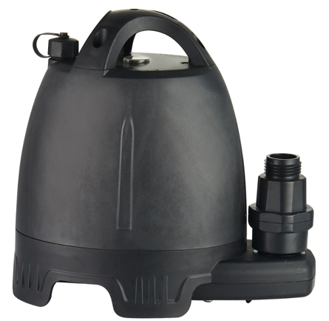
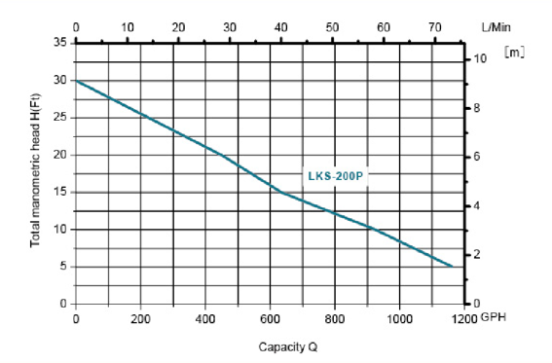
Inlet | /
Discharge | 1 in NPT
Pump Cover | PA66-GF25
Motor Housing | /
Pump Body | PP-GF30
Switch Type | push-button type
Impeller | PPO_GF30
Seal Design | Oil seal
Seal Material | /
Oil Filled Motor | lithium battery
Power Cord | No cord
Net Weight (lbs) | 5.28 lbs
Gross Weight (lbs) | 6.0 lbs
Package Size (in) | 9.1*5.8*9.1
Motor Wires | /
Self-Priming | yes
Certification | UL
LEO Model #LKS-200P
1/6 HP Submersible Battery Utility Pump
Features & Benefits:
Excellent backup during power outage or when no power source is available.
Waterproof switch provides either AC or DC power supply.
Overload protection and Dry-running protection.
Keeps working for 30 mins from single Charge
Patented Design.
Voltage: 18V
Input Power：1/6HP
MAX Flow: 1450GPH
Model | HP | Voltage | AMP | Discharge NPT(In) | GPH of water @ Total Ft. of Head |  |  |  |  | Max.Head Ft
 |  |  |  |  | 5 ft | 10 ft | 15 ft | 20 ft | 25 ft
LKS-200P | 1/6 | 18V DC | 10A | 1 | 1163 | 925 | 635 | 450 | 230 | 30

Slide 5

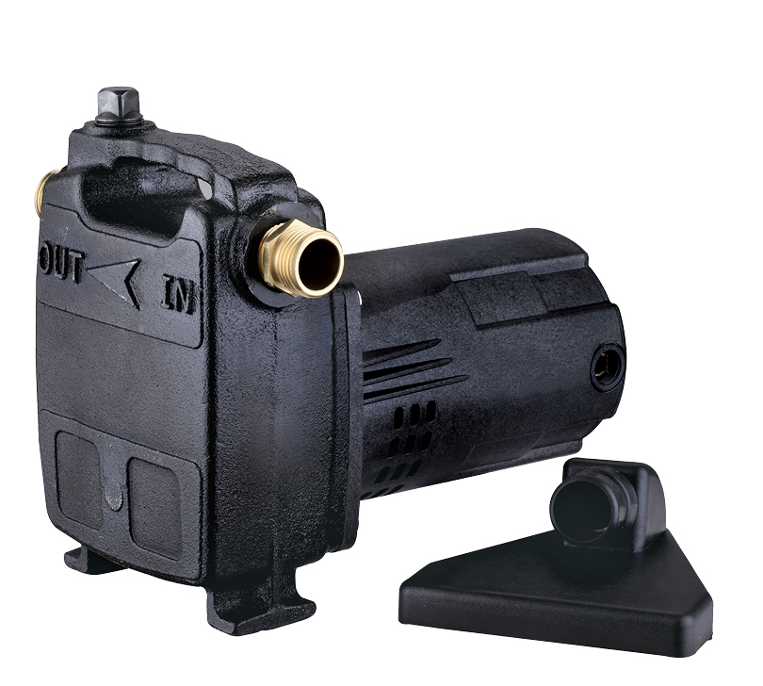
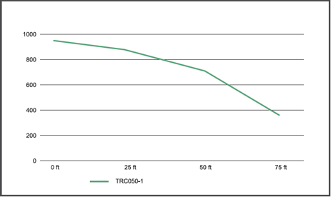
Model #PM050B
½HP Portable Cast Iron Transfer Pump
Inlet | 3/4 inNPT
Discharge | 3/4 inNPT
Pump Cover | /
Motor Housing | PC+30%GF
Pump Body | HT200
Switch Type | /
Impeller | PPO
Seal Design | O-ring
Seal Material | Silicone rubber
Oil Filled Motor | No
Power Cord | SJT 221F VW-1 16AWG×3C FT1 7.9ft
Net Weight (lbs) | 14.6
Gross Weight (lbs) | 16
Package Size | 11.614in*6.693in*8.661in
Expected Life Cycle | 2000 Hours
Motor Wires | Copper
Self-Priming | No
Certification | CSA
Features & Benefits:
Convenient carrying handle for easy transport
Durable cast iron volute
Built-in automatic thermal overload protector
3/4’’ brass adapters connect to standard garden hose
Water suction attachment included
2-year warranty
Model | HP | Voltage | AMP | Discharge NPT(In) | GPH of water @ Total Ft. of Head |  |  |  |  | Max.Head Ft
 |  |  |  |  | 0 ft | 25 ft | 50 ft | 75 ft
PM050B | 1/2 | 115 | 0.8A | ¾” | 950 | 897 | 739 | 380 |  | 80

Slide 6
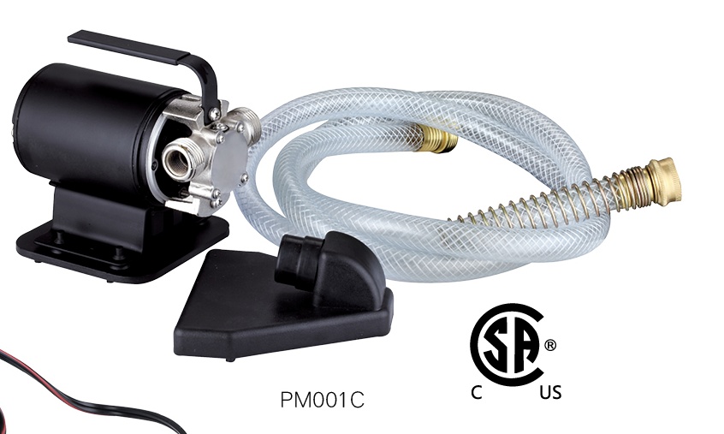
Model #PM001C
Portable Transfer Pump
Inlet | 3/4 inNH
Discharge | 3/4 inNH
Pump Cover | Stainless steel1Cr13-3Cr13
Motor Housing | Mild steel10#
Pump Body | Brass HPb59-1
Switch Type | /
Impeller | Synthetic rubber EPDM
Seal Design | O-ring
Seal Material | Silicone rubber
Oil Filled Motor | no
Power Cord | SJT 221F VW-1 18AWG×3C FT1 5.9ft
Net Weight (lbs) | 4.7
Gross Weight (lbs) | 7
Package Size | 9.449in*9.449in*5.906in
Motor Wires | Copper
Self-Priming | No
Certification | CSA
Features & Benefits:
Built-in automatic thermal overload protection.
Convenient carrying handle for easy transport.
¾” NPT discharge.
Garden hose included.
6ft power cord.
1 year warranty.
Model | HP | Voltage | AMP | Discheage NPT(In) | GPH of water @ Total Ft. of Head |  |  |  |  | Max.Head Ft
 |  |  |  |  | 5 ft | 15 ft | 25 ft | 35 ft | 45 ft
PM001C | 1/10 | 115 | 1.8 | 3/4 | 365 | 310 | 259 | 160 | 27 | 46

Slide 7
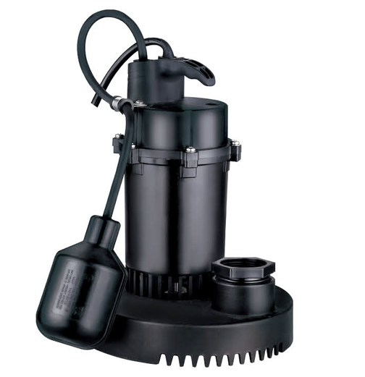
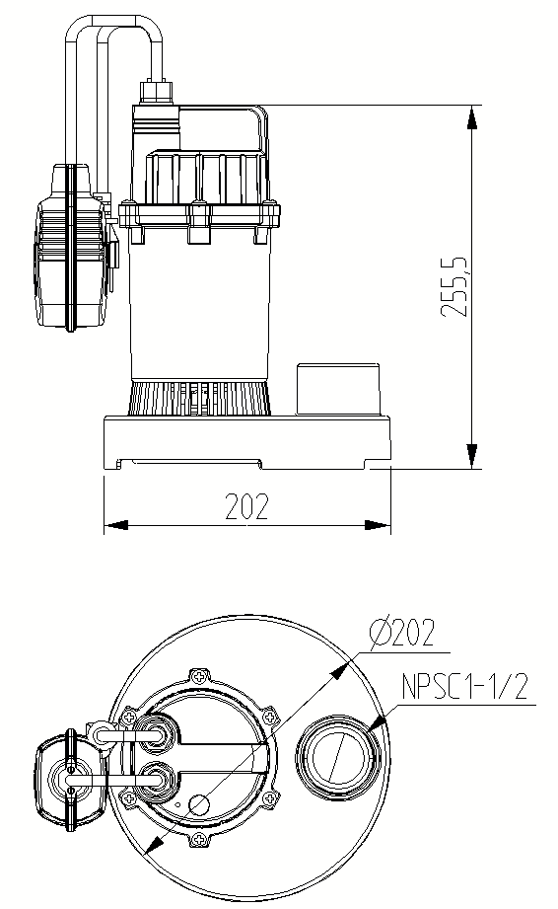
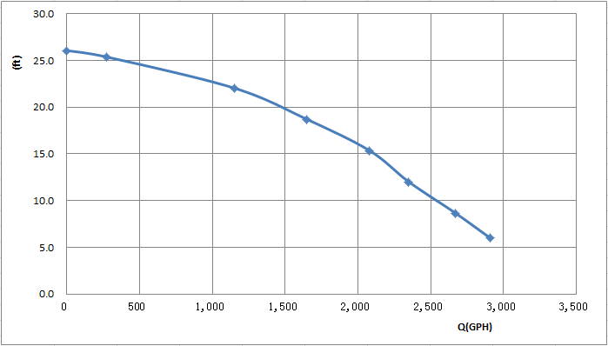
Model #LSD-252PLT
1/3 HP Thermoplastic Submersible Sump Pump
Inlet | Diameter 16.5 inches
Discharge | NPSC1-1/2
Pump Cover | PA66-GF25
Motor Housing | ZL104
Pump Body | PP-TD20
Switch Type | Float switch
Impeller | PP-GF30
Seal Design | Framework oil seal
Seal Material | NBR
Oil Filled Motor | Yes
Power Cord | SJTW 18AWG 10ft
Net Weight | 8.7
Gross Weight | 9.8
Package Size | 9*8.5*11.8
Expected Life Cycle | 4000 Hours
Motor Wires | Aluminum
Self-Priming | /
Certification | UL
Features & Benefits:
Corrosion-resistant, reinforced thermoplastic construction.
Built-in automatic thermal overload protector.
Oil-filled split capacitor motor.
Adjustable tethered float switch.
Top suction screened design prevents clogs.
10ft power cord.
1 year warranty.
Model | HP | Voltage | AMP | Discharge NPT(In) | GPH of water @ Total Ft. of Head |  |  |  |  | Max.Head Ft
 |  |  |  |  | 5 ft | 10 ft | 15 ft | 20 ft | 25 ft
LSD-252PLT | 1/3 | 115 | 4.6 | 1-1/2 | 2560 | 2300 | 1900 | 1000 | 100 | 23

Slide 8
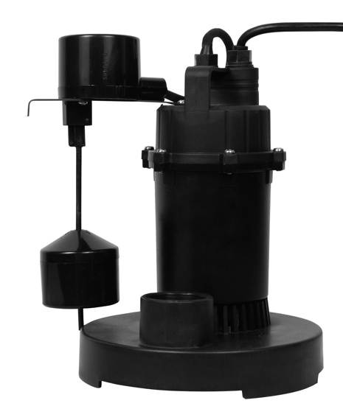
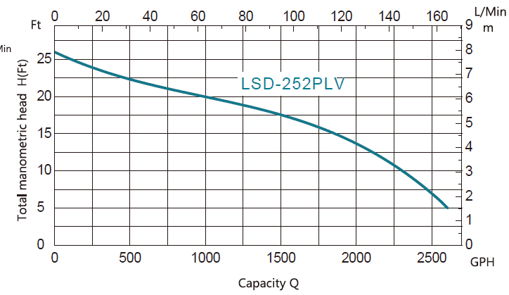
Model #LSD-252PLV
1/3 HP Thermoplastic Submersible Sump Pump
Inlet | Diameter 16.5 inches
Discharge | NPSC1-1/2
Pump Cover | PA66-GF25
Motor Housing | ZL104
Pump Body | PP-TD20
Switch Type | Float switch
Impeller | PP-GF30
Seal Design | Framework oil seal
Seal Material | NBR
Oil Filled Motor | Yes
Power Cord | SJTW 18AWG 10ft
Net Weight (lbs) | 8.7
Gross Weight (lbs) | 9.8
Package Size | 9.1*8.5*11.8
Expected Life Cycle | 4000 Hours
Motor Wires | Aluminum
Self-Priming | /
Certification | UL
Features & Benefits:
Corrosion-resistant, reinforced thermoplastic construction.
Built-in automatic thermal overload protector.
Oil-filled split capacitor motor.
Adjustable vertical float switch.
Top suction screened design prevents clogs.
10ft power cord.
1 year warranty.
Model | HP | Voltage | AMP | Discharge NPT(In) | GPH of water @ Total Ft. of Head |  |  |  |  | Max.Head Ft
 |  |  |  |  | 5 ft | 10 ft | 15 ft | 20 ft | 25 ft
LSD-253PLV | 1/3 | 115 | 4.6 | 1-1/2 | 2560 | 2300 | 1900 | 1000 | 100 | 26

Slide 9
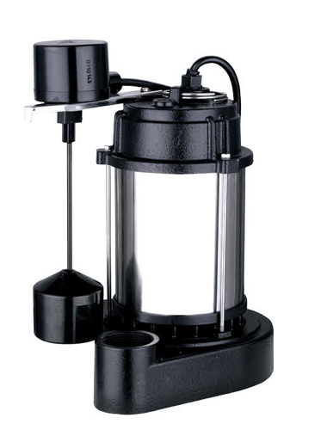
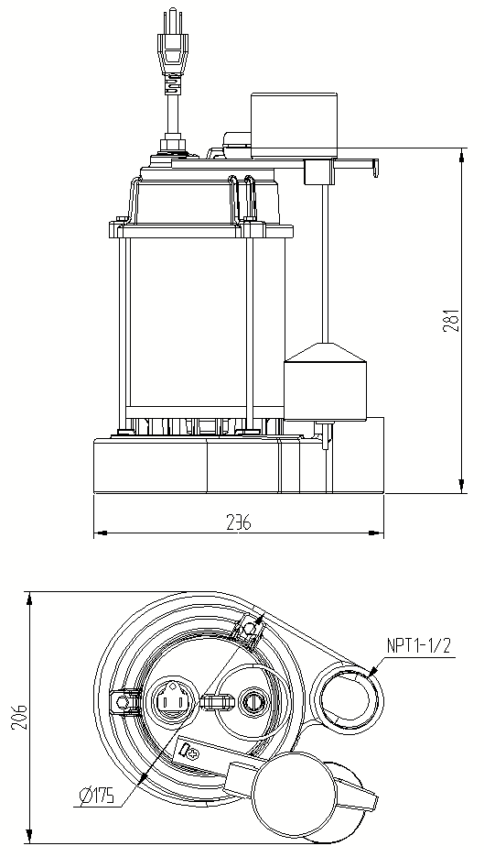
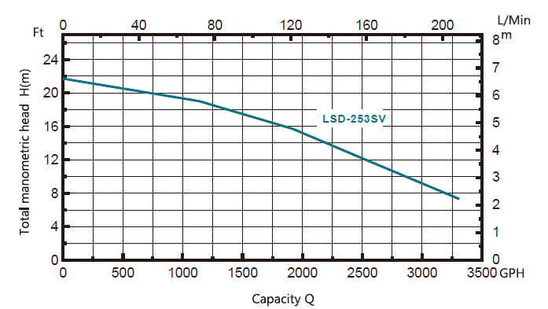
Model #LSD-253SV
1/3 HP Stainless Steel Housing-Cast Iron Base Sump Pump
Inlet | Diameter 18 inches
Discharge | NPT1/1/2
Pump Cover | HT200
Motor Housing | 304
Pump Body | HT200
Switch Type | Vertical
Impeller | PA6-GF40
Seal Design | Framework oil seal
Seal Material | NBR
Oil Filled Motor | YES
Power Cord | SJTW 18AWG 8ft
Net Weight (lbs) | 21.4
Gross Weight (lbs) | 23.6
Package Size(in) | 11×8.3×15.2
Expected Life Cycle | 4000 Hours
Motor Wires | Copper
Self-Priming | /
Certification | CSA
Features & Benefits:
Stainless steel motor shell with durable cast iron volute.
Oil-filled permanent split capacitor motor.
Built-in automatic thermal overload protector.
Vertical float switch for automatic operation.
1 ½ “ discharge.
Sturdy pump base prevent clogs and prevents pump from moving around in the pit.
8ft power cord.
3-year warranty.
Model | HP | Voltage | AMP | Discharge NPT(In) | GPH of water @ Total Ft. of Head |  |  |  |  | Max.Head Ft
 |  |  |  |  | 5 ft | 10 ft | 15 ft | 20 ft | 25 ft
LSD-253SV | 1/3 | 115 | 4.5 | 1-1/2 | 3300 | 2800 | 2000 | 750 |  | 22

Slide 10
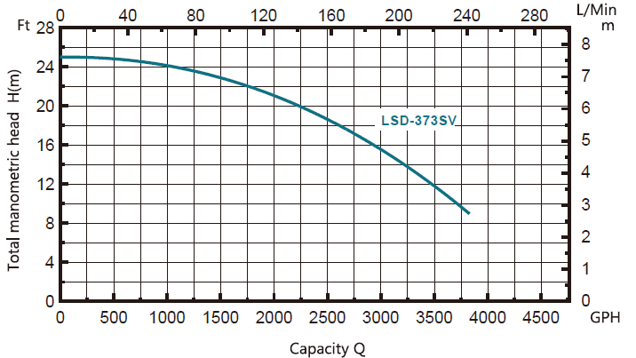
Model #LSD-373SV
Inlet | Diameter 18 inches
Discharge | NPT1/1/2
Pump Cover | HT200
Motor Housing | 304
Pump Body | HT200
Switch Type | SJE VMII vertical
Impeller | PA6-GF40
Seal Design | Framework oil seal
Seal Material | NBR
Oil Filled Motor | Yes
Power Cord | SJTW 18AWG 8ft
Net Weight (lbs) | 25.4
Gross Weight (lbs) | 27.4
Package Size | 11*8.3*15.2
Expected Life Cycle | 4000 Hours
Motor Wires | Copper
Self-Priming | /
Certification | CSA
1/2 HP Stainless Steel Housing-Cast Iron Base Sump Pump
Features & Benefits:
Stainless steel motor shell with durable cast iron volute.
Oil-filled permanent split capacitor motor.
Built-in automatic thermal overload protector.
Vertical float switch for automatic operation.
1 ½ “ discharge.
Sturdy pump base prevent clogs and prevents pump from moving around in the pit.
8ft power cord.
3-year warranty.
Model | HP | Voltage | AMP | Discharge NPT(In) | GPH of water @ Total Ft. of Head |  |  |  |  | Max.Head Ft
 |  |  |  |  | 5 ft | 10 ft | 15 ft | 20 ft | 25 ft
LSD-373SV | 1/2 | 115 | 5 | 1-1/2 | 3830 | 3750 | 3050 | 2250 |  | 24.6

Slide 11
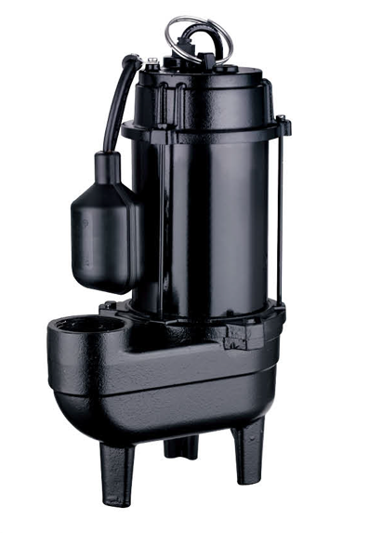
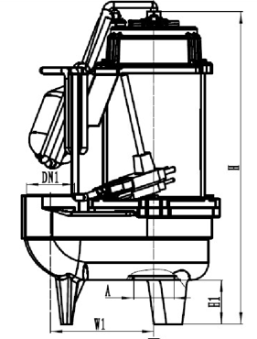
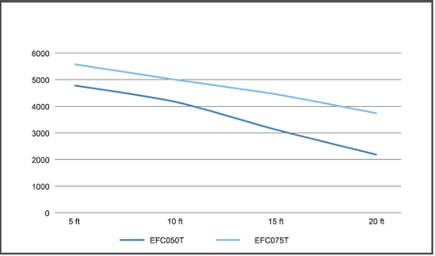
Model #USC-37WE
½ HP Cast Iron Effluent Pump
Inlet | 3/4inch
Discharge | NPT2
Pump Cover | HT200
Motor Housing | 08F
Pump Body | HT200
Switch Type | Float switch
Impeller | PA6-GF25
Seal Design | Mechanical seal
Seal Material | Graphite & Ceramic
Oil Filled Motor | Yes
Power Cord | SJTW3*18AWG
Net Weight (lbs) | 29
Gross Weight (lbs) | 30.6
Package Size | 11.2*7.5*17.1
Expected Life Cycle | ON-OFF 300,000 Times
Motor Wires | Copper
Self-Priming | No
Certification | CSA
Features & Benefits:
Durable cast iron construction.
Heavy-duty cast-iron volute and nylon impeller.
Built-in automatic thermal overload protector motor.
Adjustable piggyback float switch for automatic operation.
Application up to 3/4” diameter solids.
2” NPT discharge.
10ft power cord.
2-year warranty.
Model | HP | Voltage | AMP | Discharge NPT(In) | GPH of water @ Total Ft. of Head |  |  |  |  | Max.Head Ft
 |  |  |  |  | 5 ft | 10 ft | 15 ft | 20 ft | 25 ft
USC-37WE | 1/2 | 120 | 7.8 | 2 | 4800 | 4050 | 3200 | 2200 | 1379 | 27

Slide 12
Model #USC-37WE-20
½ HP Cast Iron Effluent Pump
Inlet | 3/4inch
Discharge | NPT2
Pump Cover | HT200
Motor Housing | 08F
Pump Body | HT200
Switch Type | Float switch
Impeller | PA6-GF25
Seal Design | Mechanical seal
Seal Material | Graphite & Ceramic
Oil Filled Motor | Yes
Power Cord | SJTW3*18AWG
Net Weight (lbs) | 32
Gross Weight (lbs) | 34
Package Size | 11.2*7.5*17.1
Expected Life Cycle | ON-OFF 300,000 Times
Motor Wires | Copper
Self-Priming | No
Certification | CSA
Features & Benefits:
Durable cast iron construction.
Heavy-duty cast-iron volute and nylon impeller.
Built-in automatic thermal overload protector motor.
Adjustable tethered or piggyback float switch for automatic operation.
Application up to 3/4” diameter solids.
2” NPT discharge.
20ft power cord.
2-year warranty.
Model | HP | Voltage | AMP | Discharge NPT(In) | GPH of water @ Total Ft. of Head |  |  |  |  | Max.Head Ft
 |  |  |  |  | 5 ft | 10 ft | 15 ft | 20 ft | 25 ft
USC-37WE-20 | 1/2 | 120 | 7.8 | 2 | 4800 | 4050 | 3200 | 2200 | 1379 | 27

Slide 13
Model #USC-56WE
3/4 HP Cast Iron Effluent Pump
Inlet | 3/4inch
Discharge | NPT2
Pump Cover | HT200
Motor Housing | 08F
Pump Body | HT200
Switch Type | Float switch
Impeller | PA6-GF25
Seal Design | Mechanical seal
Seal Material | Graphite & Ceramic
Oil Filled Motor | Yes
Power Cord | SJTW3*18AWG
Net Weight (lbs) | 31
Gross Weight (lbs) | 33
Package Size | 11.2*7.5*17.1
Expected Life Cycle | ON-OFF 300,000 Times
Motor Wires | Copper
Self-Priming | No
Certification | CSA
Features & Benefits:
Durable cast iron construction.
Heavy duty cast iron volute and nylon impeller.
Built-in automatic thermal overload protector motor.
Adjustable tethered or piggyback float switch for automatic operation.
Application up to 3/4” diameter solids.
2” NPT discharge.
10ft power cord.
2-year warranty.
Model | HP | Voltage | AMP | Discharge NPT(In) | GPH of water @ Total Ft. of Head |  |  |  |  | Max.Head Ft
 |  |  |  |  | 5 ft | 10 ft | 15 ft | 20 ft | 25 ft
USC-56WE | 3/4 | 120 | 10A | 2 | 5600 | 5000 | 4400 | 3750 | 2498 | 37

Slide 14
Model #USC-56WE-20
3/4 HP Cast Iron Effluent Pump
Inlet | 3/4inch
Discharge | NPT2
Pump Cover | HT200
Motor Housing | 08F
Pump Body | HT200
Switch Type | Float switch
Impeller | PA6-GF25
Seal Design | Mechanical seal
Seal Material | Graphite & Ceramic
Oil Filled Motor | Yes
Power Cord | SJTW3*18AWG
Net Weight (lbs) | 34
Gross Weight (lbs) | 36
Package Size | 11.2*7.5*17.1
Expected Life Cycle | ON-OFF 300,000 Times
Motor Wires | Copper
Self-Priming | No
Certification | CSA
Features & Benefits:
Durable cast iron construction.
Heavy-duty cast-iron volute and nylon impeller.
Built-in automatic thermal overload protector motor.
Adjustable tethered or piggyback float switch for automatic operation.
Application up to 3/4” diameter solids.
2” NPT discharge.
20ft power cord.
2-year warranty.
Model | HP | Voltage | AMP | Discharge NPT(In) | GPH of water @ Total Ft. of Head |  |  |  |  | Max.Head Ft
 |  |  |  |  | 5 ft | 10 ft | 15 ft | 20 ft | 25 ft
USC-56WE-20 | 3/4 | 120 | 10A | 2 | 5600 | 5000 | 4400 | 3750 | 2498 | 37

Slide 15

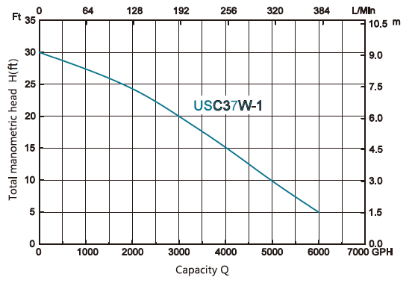
Model #USC37W-1
Inlet | 2 inch
Discharge | NPT2
Pump Cover | HT200
Motor Housing | 08F
Pump Body | HT200
Switch Type | Float switch
Impeller | PA6-GF25
Seal Design | Mechanical seal
Seal Material | Carborundum & Carborundum
Oil Filled Motor | Yes
Power Cord | SJTW3*18AWG
Net Weight (lbs) | 32 lbs
Gross Weight (lbs) | 34.8 lbs
Package Size | 11.2*7.5*17.6 inches
Expected Life Cycle | ON 10 Sec. OFF 30 Sec. 100,000 cycles
Motor Wires | Copper
Self-Priming | No
Certification | CSA
½ HP Cast Iron Sewage Pump
Features & Benefits:
Durable cast iron construction.
Heavy-duty cast-iron volute and nylon impeller.
Built-in automatic thermal overload protector motor.
Adjustable tethered or piggyback float switch for automatic operation.
Application up to 2” diameter solids.
2” NPT discharge.
10ft power cord.
2-year warranty.
Model | HP | Voltage | AMP | Discharge NPT(In) | GPH of water @ Total Ft. of Head |  |  |  |  | Max.Head Ft
 |  |  |  |  | 5 ft | 10 ft | 15 ft | 20 ft | 25 ft
USC37W-1 | 1/2 | 120 | 9.5 | 2 | 6000 | 4950 | 4050 | 3000 | 1950 | 30

Slide 16
Inlet | 2 inch
Discharge | NPT2
Pump Cover | HT200
Motor Housing | 08F
Pump Body | HT200
Switch Type | Float switch
Impeller | PA6-GF25
Seal Design | Mechanical seal
Seal Material | Carborundum & Carborundum
Oil Filled Motor | Yes
Power Cord | SJTW3*18AWG
Net Weight (lbs) | 36 lbs
Gross Weight( lbs) | 38 lbs
Package Size | 11.2*7.5*17.6 inches
Expected Life Cycle | ON 10 Sec. OFF 30 Sec. 100,000 cycles
Motor Wires | Copper
Self-Priming | No
Certification | CSA
Model #USC37W-1-20
½ HP Cast Iron Sewage Pump
Features & Benefits:
Durable cast iron construction.
Heavy-duty cast-iron volute and nylon impeller.
Built-in automatic thermal overload protector motor.
Adjustable tethered or piggyback float switch for automatic operation.
Application up to 2” diameter solids.
2” NPT discharge.
20ft power cord.
2-year warranty.
Model | HP | Voltage | AMP | Discharge NPT(In) | GPH of water @ Total Ft. of Head |  |  |  |  | Max.Head Ft
 |  |  |  |  | 5 ft | 10 ft | 15 ft | 20 ft | 25 ft
USC37W-1-20 | 1/2 | 120 | 9.5 | 2 | 6000 | 4950 | 4050 | 3000 | 1950 | 30

Slide 17
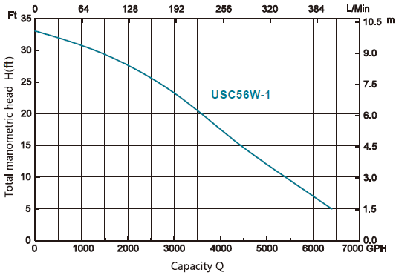
Inlet | 2 inch
Discharge | NPT2
Pump Cover | HT200
Motor Housing | 08F
Pump Body | HT200
Switch Type | Float switch
Impeller | PA6-GF25
Seal Design | Mechanical seal
Seal Material | Carborundum & Carborundum
Oil Filled Motor | Yes
Power Cord | SJTW3*18AWG
Net Weight (lbs) | 33 lbs
Gross Weight (lbs) | 36 lbs
Package Size | 11.2*7.5*17.6 inches
Expected Life Cycle | ON 10 Sec. OFF 30 Sec. 100,000 cycles
Motor Wires | Copper
Self-Priming | No
Certification | CSA
Model #USC56W-1
3/4 HP Cast Iron Sewage Pump
Features & Benefits:
Durable cast iron construction.
Heavy-duty cast-iron volute and nylon impeller.
Built-in automatic thermal overload protector motor.
Adjustable tethered or piggyback float switch for automatic operation.
Application up to 2” diameter solids.
2” NPT discharge.
10ft power cord.
2-year warranty.
Model | HP | Voltage | AMP | Discharge NPT(In) | GPH of water @ Total Ft. of Head |  |  |  |  | Max.Head Ft
 |  |  |  |  | 5 ft | 10 ft | 15 ft | 20 ft | 25 ft
USC56W-1 | 3/4 | 120 | 10 | 2 | 6400 | 5400 | 4400 | 3600 | 2700 | 33

Slide 18
Inlet | 2 inch
Discharge | NPT2
Pump Cover | HT200
Motor Housing | 08F
Pump Body | HT200
Switch Type | Float switch
Impeller | PA6-GF25
Seal Design | Mechanical seal
Seal Material | Carborundum & Carborundum
Oil Filled Motor | Yes
Power Cord | SJTW3*18AWG
Net Weight (lbs) | 38
Gross Weight (lbs) | 40
Package Size | 11.2*7.5*17.1
Expected Life Cycle | ON 10 Sec. OFF 30 Sec. 100,000 cycles
Motor Wires | Copper
Self-Priming | No
Certification | CSA
Model #USC56W-1-20
3/4 HP Cast Iron Sewage Pump
Features & Benefits:
Durable cast iron construction.
Heavy-duty cast-iron volute and nylon impeller.
Built-in automatic thermal overload protector motor.
Adjustable tethered or piggyback float switch for automatic operation.
Application up to 2” diameter solids.
2” NPT discharge.
20ft power cord.
2-year warranty.
Model | HP | Voltage | AMP | Discharge NPT(In) | GPH of water @ Total Ft. of Head |  |  |  |  | Max.Head Ft
 |  |  |  |  | 5 ft | 10 ft | 15 ft | 20 ft | 25 ft
USC-56W-1-20 | 3/4 | 120 | 9.5 | 2 | 6400 | 5400 | 4400 | 3600 | 2700 | 33

Slide 19
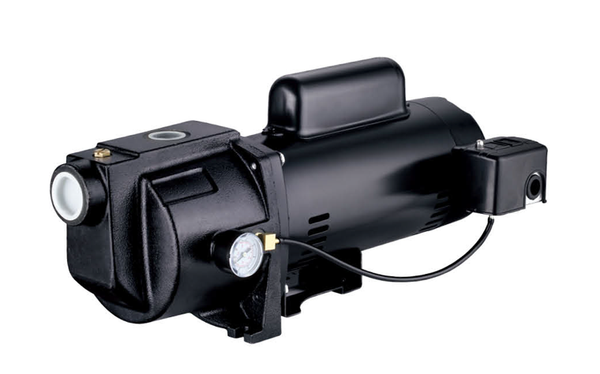
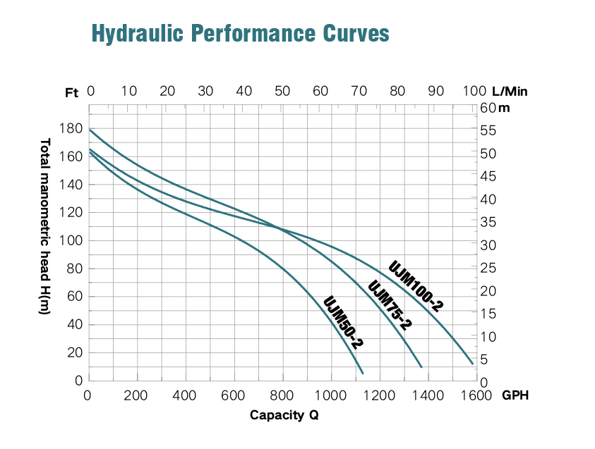
Model #UJM50-2
1 HP Dual Voltage Cast Iron Shallow Well Jet Pump
Inlet | NPT 1 1/4
Discharge | NPT1
Pump Cover | /
Motor Housing | ZL102
Pump Body | HT200
Switch Type | Press switch
Impeller | PPO-GF30
Seal Design | Mechanical seal
Seal Material | Graphite & Ceramic
Oil Filled Motor | No
Power Cord | /
Net Weight (lbs) | 44.4
Gross Weight (lbs) | 51
Package Size | 22.3*13.6*11.6
Expected Life Cycle | ON 2 sec. OFF 2 sec. 300,000 cycles
Motor Wires | Copper
Self-Priming | Yes
Certification | UL
Features & Benefits:
For use with shallow well within 25ft.
Durable cast iron pump body.
Built-in automatic thermal overload protection.
Dual voltage motor (115/230V), Factory set for 115V.
Pressure switch pre-set at 30-50 PSI.
1 ¼” NPT discharge and 1” NPT discharge.
NEMA Motor.
3-year warranty.
Model | HP | Voltage | AMP | Discharge NPT(In) | GPH of water @ Total Ft. of Head |  |  |  |  | Max.Head Ft
 |  |  |  |  | 5 ft | 35 ft | 70 ft | 100 ft | 130 ft
UJM50-2 | 1 | 115/230 | 13/6.5 | 1 | 1150 | 1050 | 960 | 630 | 260 | 162

Slide 20
Model #UJM100-2
1 HP Dual Voltage Cast Iron Shallow Well Jet Pump
Inlet | NPT 1 1/4
Discharge | NPT1
Pump Cover | /
Motor Housing | ZL102
Pump Body | HT200
Switch Type | Press switch
Impeller | PPO-GF30
Seal Design | Mechanical seal
Seal Material | Graphite & Ceramic
Oil Filled Motor | No
Power Cord | /
Net Weight (lbs) | 49
Gross Weight (lbs) | 51
Package Size | 22.3*13.6*11.6
Expected Life Cycle | ON 2 sec. OFF 2 sec. 300,000 cycles
Motor Wires | Copper
Self-Priming | Yes
Certification | UL
Features & Benefits:
For use with shallow well within 25ft.
Durable cast iron pump body.
Built-in automatic thermal overload protection.
Dual voltage motor (115/230V), Factory set for 230V.
Pressure switch pre-set at 30-50 PSI.
1 ¼” NPT discharge and 1” NPT discharge.
NEMA Motor.
3-year warranty.
Model | HP | Voltage | AMP | Discharge NPT(In) | GPH of water @ Total Ft. of Head |  |  |  |  | Max.Head Ft
 |  |  |  |  | 5 ft | 35 ft | 70 ft | 100 ft | 130 ft
UJM100-2 | 1 | 115/230 | 16/8 | 1 | 1550 | 1500 | 1270 | 950 | 500 | 180

Slide 21
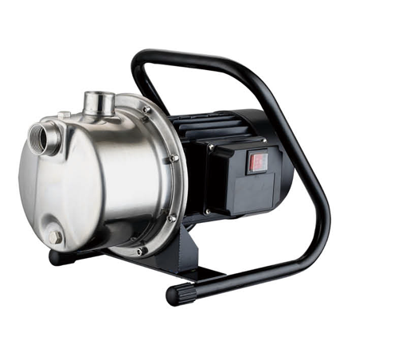

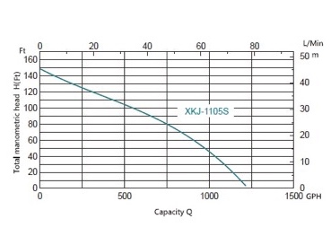
1 ½ HP Irrigation/Lawn Sprinkler Pump
Inlet | NPT1
Discharge | NPT1
Pump Cover | ZL102
Motor Housing | ZL102
Pump Body | Stainless steel
Switch Type | Water-proof switch _KCD4(UL)
Impeller | PPO-GF30
Seal Design | Mechanical seal
Seal Material | Graphite & Ceramic
Oil Filled Motor | No
Power Cord | YY-3_3C*SJTW 16AWG*6.6ft
Net Weight (lbs) | 23
Gross Weight (lbs) | 28
Package Size | 15.4*9.9*10.8
Expected Life Cycle | 4000 Hours
Motor Wires | Aluminum
Self-Priming | No
Certification | ETL
Model #XKJ-1105S
Features & Benefits:
Durable stainless-steel volute with front drain plug.
Built-in automatic thermal overload protection.
Permanent split capacitor motor.
Reinforced thermoplastic impeller and corrosion resistant diffuser.
Carbon/Ceramic mechanical seal.
On/Off Switch.
1” NPT discharge.
6ft power cord.
1 year warranty.
Model | HP | Voltage | AMP | Discharge NPT(In) | GPH of water @ Total Ft. of Head |  |  |  |  | Max.Head Ft
 |  |  |  |  | 0 ft | 50 ft | 100 ft | 150 ft
XKJ-1105S | 1-1/2 | 115 | 10 | 1 | 1200 | 980 | 580 | 0 |  | 150

Slide 22
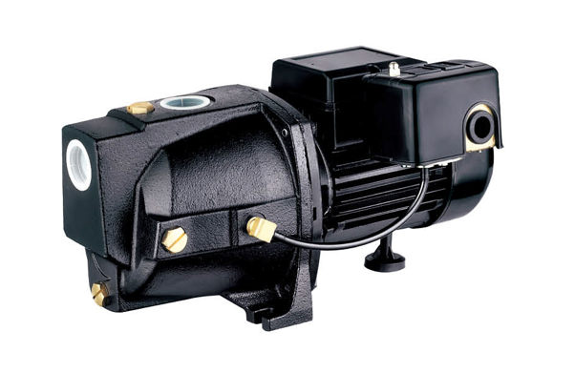
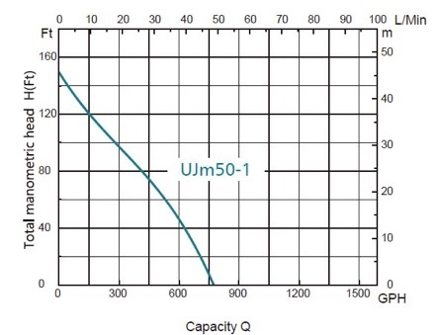
Model #UJM50-1
1/2HP Dual Voltage Cast Iron Shallow Well Jet Pump
Inlet | NPT1-1/4
Discharge | NPT1
Pump Cover | /
Motor Housing | ZL102
Pump Body | HT200
Switch Type | Press switch
Impeller | PPO-GF30
Seal Design | Mechanical seal
Seal Material | Graphite & Ceramic
Oil Filled Motor | No
Power Cord | /
Net Weight (lbs) | 19
Gross Weight (lbs) | 21
Package Size | 16 x 10.5 x 9.5
Expected Life Cycle | ON 2 sec. OFF 2 sec. 300,000 cycles
Motor Wires | Copper
Self-Priming | Yes
Certification | CSA
Features & Benefits:
For use with shallow well within 25ft.
Durable cast iron pump body.
Built-in automatic thermal overload protection.
Dual voltage motor (115/230V), Factory wired for 230V.
Pressure switch pre-set at 30-50 PSI.
1 ¼” NPT suction and 1” NPT discharge.
2-year warranty.
Model | HP | Voltage | AMP | Discharge NPT(In) | GPH of water @ Total Ft. of Head |  |  |  |  | Max.Head Ft
 |  |  |  |  | 5 ft | 35 ft | 70 ft | 100 ft | 130 ft
UJM50-1 | 1/2 | 115/230 | 6.6/3.3 | 1 | 790 | 660 | 580 | 300 | 75 | 147

Slide 23
Model #UJM75-1
3/4HP Dual Voltage Cast Iron Shallow Well Jet Pump
Inlet | NPT1-1/4
Discharge | NPT1
Pump Cover | /
Motor Housing | ZL102
Pump Body | HT200
Switch Type | Press switch
Impeller | PPO-GF30
Seal Design | Mechanical seal
Seal Material | Graphite & Ceramic
Oil Filled Motor | No
Power Cord | /
Net Weight (lbs) | 19
Gross Weight (lbs) | 21
Package Size | 16 x 10.5 x 9.5
Expected Life Cycle | ON 2 sec. OFF 2 sec. 300,000 cycles
Motor Wires | Copper
Self-Priming | Yes
Certification | CSA
Features & Benefits:
For use with shallow well within 25ft.
Durable cast iron pump body.
Built-in automatic thermal overload protection.
Dual voltage motor (115/230V), Factory wired for 230V.
Pressure switch pre-set at 30-50 PSI.
1 ¼” NPT suction and 1” NPT discharge.
2-year warranty.
Model | HP | Voltage | AMP | Discharge NPT(In) | GPH of water @ Total Ft. of Head |  |  |  |  | Max.Head Ft
 |  |  |  |  | 5 ft | 35 ft | 70 ft | 100 ft | 130 ft
UJM75-1 | ¾ | 115/230 | 9/4.5 | 1 | 1100 | 920 | 710 | 500 | 200 | 154

Slide 24
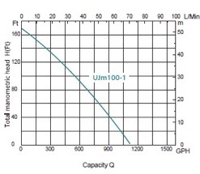
Model #UJM100-1
1HP Dual Voltage Cast Iron Shallow Well Jet Pump
Inlet | NPT1-1/4
Discharge | NPT1
Pump Cover | /
Motor Housing | ZL102
Pump Body | HT200
Switch Type | Press switch
Impeller | PPO-GF30
Seal Design | Mechanical seal
Seal Material | Graphite & Ceramic
Oil Filled Motor | No
Power Cord | /
Net Weight (lbs) | 33
Gross Weight (lbs) | 36.5
Package Size | 18.5*11.7*10
Expected Life Cycle | ON 2 sec. OFF 2 sec. 300,000 cycles
Motor Wires | Copper
Self-Priming | Yes
Certification | CSA
Features & Benefits:
For use with shallow well within 25ft.
Durable cast iron pump body.
Built-in automatic thermal overload protection.
Dual voltage motor (115/230V), Factory wired for 230V.
Pressure switch pre-set at 30-50 PSI.
1 ¼” NPT suction and 1” NPT discharge.
2-year warranty.
Model | HP | Voltage | AMP | Discharge NPT(In) | GPH of water @ Total Ft. of Head |  |  |  |  | Max.Head Ft
 |  |  |  |  | 5 ft | 35 ft | 70 ft | 100 ft | 130 ft
UJM100-1 | 1 | 115 or 230 | 9.6/4.8 | 1 | 1100 | 870 | 750 | 540 | 310 | 164

Slide 25
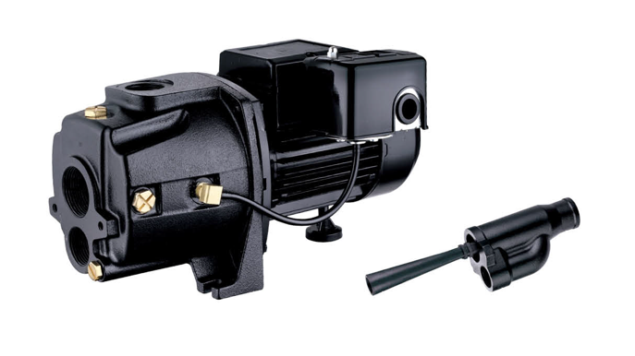
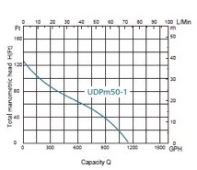
Model #UDPM50-1
½ HP Dual Voltage Cast Iron Convertible Jet Pump
Inlet | NPT1-1/4
Discharge | NPT1
Pump Cover | /
Motor Housing | ZL102
Pump Body | HT200
Switch Type | Press switch
Impeller | PPO-GF30
Seal Design | Mechanical seal
Seal Material | Graphite & Ceramic
Oil Filled Motor | No
Power Cord | /
Net Weight (lbs) | 23.9
Gross Weight (lbs) | 26.5
Package Size | 15*10.2*9
Expected Life Cycle | ON 2 sec. OFF 2 sec. 300,000 cycles
Motor Wires | Copper
Self-Priming | No
Certification | CSA
Features & Benefits:
For use on shallow well applications up to 25ft water level.
For use on deep well applications up to 25-100 feet.
Durable cast iron pump body.
Built-in automatic thermal overload protection.
Dual voltage motor (115/230V), factory wired for 230V.
Ejector is included for deep well usage.
1 ¼” NPT suction and 1” NPT discharge.
2-year warranty.
Model | HP | Voltage | AMP | Discharge NPT(In) | GPH of water @ Total Ft. of Head |  |  |  |  | Max.Head Ft
 |  |  |  |  | 5 ft | 35 ft | 70 ft | 100 ft | 128 ft
UDPM50-1 | 1/2 | 115/230 | 8.8/4.4 | 1 | 1100 | 950 | 650 | 200 | / | 128

Slide 26
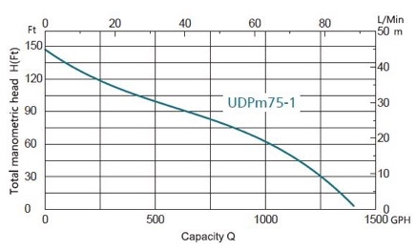
Model #UDPM75-1
3/4HP Dual Voltage Cast Iron Convertible Jet Pump
Inlet | NPT1-1/4
Discharge | NPT1
Pump Cover | /
Motor Housing | ZL102
Pump Body | HT200
Switch Type | Press switch
Impeller | PPO-GF30
Seal Design | Mechanical seal
Seal Material | Graphite & Ceramic
Oil Filled Motor | No
Power Cord | /
Net Weight (lbs) | 30
Gross Weight (lbs) | 35
Package Size | 16.3*11.4*9.6
Expected Life Cycle | ON 2 sec. OFF 2 sec. 300,000 cycles
Motor Wires | Copper
Self-Priming | No
Certification | CSA
Features & Benefits:
For use on shallow well applications up to 25ft water level.
For use on deep well applications up to 25-130 feet.
Durable cast iron pump body.
Built-in automatic thermal overload protection.
Dual voltage motor (115/230V), factory wired for 230V.
Ejector is included for deep well usage.
1 ¼” NPT suction and 1” NPT discharge.
2-year warranty.
Model | HP | Voltage | AMP | Discharge NPT(In) | GPH of water @ Total Ft. of Head |  |  |  |  | Max.Head Ft
 |  |  |  |  | 5 ft | 35 ft | 70 ft | 100 ft | 130 ft
UDPM75-1 | 3/4 | 115/230 | 12.6/6.3 | 1 | 1400 | 1220 | 900 | 430 | 125 | 147

Slide 27
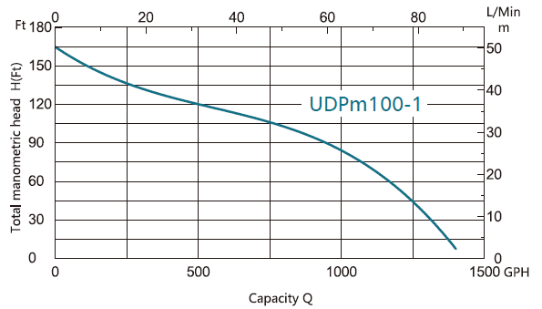
Model #UDPM100-1
1HP Dual Voltage Cast Iron Convertible Jet Pump
Inlet | NPT1-1/4
Discharge | NPT1
Pump Cover | /
Motor Housing | ZL102
Pump Body | HT200
Switch Type | Press switch
Impeller | PPO-GF30
Seal Design | Mechanical seal
Seal Material | Graphite & Ceramic
Oil Filled Motor | No
Power Cord | /
Net Weight (lbs) | 33
Gross Weight (lbs) | 36.5
Package Size | 16.3*11.4*9.6
Expected Life Cycle | ON 2 sec. OFF 2 sec. 300,000 cycles
Motor Wires | Copper
Self-Priming | No
Certification | CSA
Features & Benefits:
For use on shallow well applications up to 25ft water level.
For use on deep well applications up to 25-310 feet.
Durable cast iron pump body.
Built-in automatic thermal overload protection.
Dual voltage motor (115/230V), factory wired for 230V.
Ejector is included for deep well usage.
1 ¼” NPT suction and 1” NPT discharge.
2-year warranty.
Model | HP | Voltage | AMP | Discharge NPT(In) | GPH of water @ Total Ft. of Head |  |  |  |  | Max.Head Ft
 |  |  |  |  | 5 ft | 35 ft | 70 ft | 100 ft | 130 ft
UDPM100-1 | 1 | 115 /230 | 15.4/7.7 | 1 | 1400 | 1320 | 1050 | 790 | 310 | 164

Slide 28
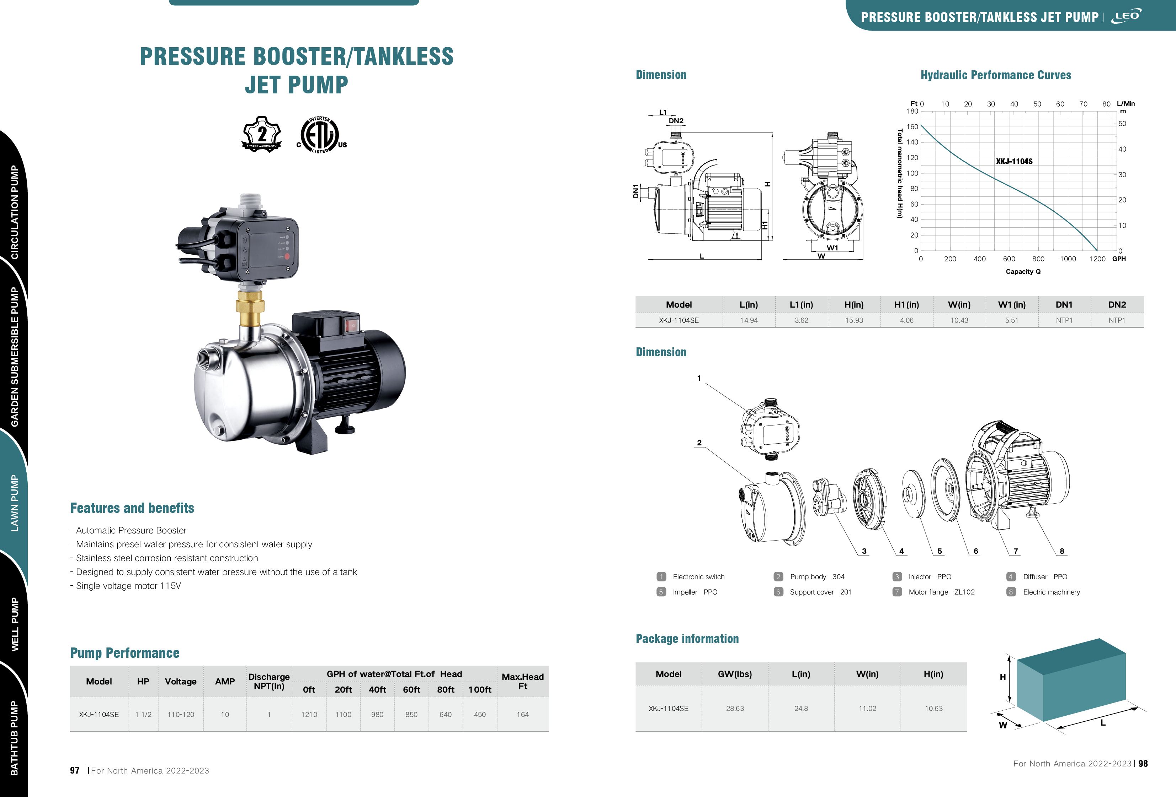
Model #XKJ-1104SE
1 ½ HP Stainless Steel Tankless Booster Pump
Inlet | NPT1
Discharge | NPT1
Pump Cover | ZL102
Pump Body | 304
Switch Type | Water-proof switch _KCD4(UL)
Impeller | PPO-GF30
Seal Design | Mechanical seal
Seal Material | Graphite & Ceramic
Oil Filled Motor | No
Power Cord | 16AWG*6.4ft（16AWG*1.6ft）
Net Weight | 22.7
Gross Weight | 25.4
Package Size | 24.9*11.02*10.83
Expected Life Cycle | 4000 Hours
Motor Wires | Aluminum
Self-Priming | No
Certification | ETL
Features & Benefits:
For use on shallow well applications up to 164ft water level.
Mounted with a pressure regulator.
Electronic system eliminates the conventional tanks & pressure switch.
Regulates and controls rate and flow of water.
Protects pumps from running dry when low water level in well.
6ft power cord.
2-year warranty.
Model | HP | Voltage | AMP | Discharge NPT(In) | GPH of water @ Total Ft. of Head |  |  |  |  | Max.Head Ft
 |  |  |  |  | 0 ft | 20 ft | 40 ft | 60 ft | 80 ft
XKJ-1104SE | 1-1/2 | 115 | 10 | 1 | 1210 | 1100 | 980 | 850 |  | 164

Slide 29
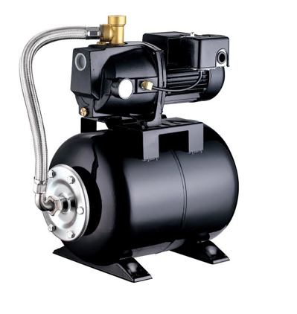
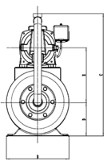
Model #UJM50-1A3
Inlet | NPT1-1/4
Discharge | NPT1
Pump Cover | /
Motor Housing | ZL102
Pump Body | HT200
Switch Type | Press switch
Impeller | PPO-GF30
Seal Design | Mechanical seal
Seal Material | Graphite & Ceramic
Oil Filled Motor | No
Power Cord | /
Net Weight (lbs) | 19
Gross Weight (lbs) | 21.7
Package Size | 22.8*15.5*21.1
Expected Life Cycle | ON 2 SEC OFF 2 sec. 300,000 cycles
Motor Wires | Copper
Self-Priming | No
Certification | CSA
½ HP Shallow Well Jet Pump C/W Pressure Tank
Features & Benefits:
For use on shallow well applications up to 25ft water level.
Durable cast iron pump housing.
Built-in thermal overload protection.
Fully automatic water supply.
Dedicated priming port for volute filling.
1 ¼” NPT suction and 1” NPT discharge.
Complete with 6-gallon tank.
2-year warranty.
Model | HP | Voltage | AMP | Discharge NPT(In) | GPH of water @ Total Ft. of Head |  |  |  |  | Max.Head Ft
 |  |  |  |  | 5 ft | 35 ft | 70 ft | 100 ft | 130 ft
UJM50-1A3 | 1/2 | 115/230 | 6.6/3.3 | 1 | 790 | 660 | 580 | 300 | 75 | 147

Slide 30
Model #UJM100-1A3
1 HP Shallow Well Jet Pump C/W Pressure Tank
Inlet | NPT1-1/4
Discharge | NPT1
Pump Cover | /
Motor Housing | ZL102
Pump Body | HT200
Switch Type | Press switch
Impeller | PPO-GF30
Seal Design | Mechanical seal
Seal Material | Graphite & Ceramic
Oil Filled Motor | No
Power Cord | /
Net Weight (lbs) | 29
Gross Weight (lbs) | 32
Package Size | 20.3*12.4*22.3
Expected Life Cycle | ON 2 SEC OFF 2 sec. 300,000 cycles
Motor Wires | Copper
Self-Priming | No
Certification | CSA
Features & Benefits:
For use on shallow well applications up to 25ft water level.
Durable cast iron pump housing.
Built-in thermal overload protection.
Fully automatic water supply.
Dedicated priming port for volute filling.
1 ¼” NPT suction and 1” NPT discharge.
Complete with 6-gallon tank.
2-year warranty.
Model | HP | Voltage | AMP | Discharge NPT (In) | GPH of water @ Total Ft. of Head |  |  |  |  | Max.Head Ft
 |  |  |  |  | 5 ft | 35 ft | 70 ft | 100 ft | 130 ft
UJM100-1A3 | 1 | 115 or 230 | 9.6/4.8 | 1 | 1100 | 870 | 750 | 540 | 310 | 164

Slide 31
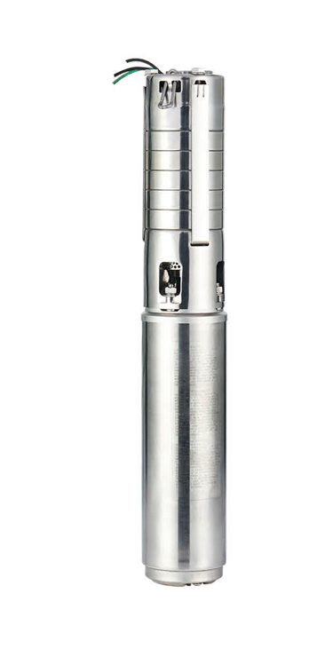
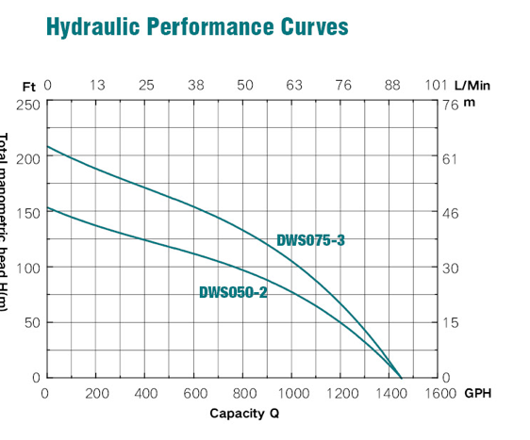
Model #DWS050-2
Submersible Deep Well Pump
Inlet | /
Discharge | NPT1-1/4
Pump Cover | /
Motor Housing | AISI304
Pump Body | AISI304
Switch Type | /
Impeller | AISI304
Seal Design | Motor laser welding seal
Seal Material | /
Oil Filled Motor | Water filled
Power Cord | 2 wires, UL3173 14AWG ,length:1m
Net Weight (lbs) | 26.4 lbs
Gross Weight (lbs) | 27. 8lbs
Package Size | 24.4*5.5*5.9 inches
Expected Life Cycle | On 2 sec. Off 2 sec. 300,000 cycles
Motor Wires | Copper
Self-Priming | No
Certification | CSA
Features & Benefits:
Fits inside any 4'‘ opening
Water cooled submersible motor
Corrosion-resistant stainless-steel pump and motor housing
2-wire installation does not require a control box
1-1/4'‘ NPT discharge designed to fit most applications
5-year warranty
Model | HP | Voltage | Discharge | GPH of water @ Total Ft. of Head |  |  |  |  |  | Max.Head
 |  |  | NPT(In) | 0 ft | 50 ft | 100 ft | 150 ft | 200 ft |  | Ft
DWS050-2 | 1/2 | 230V | 1-1/4 in | 1450 | 1190 | 785 | 700 | 30 |  | 155
DWS075-3 | 3/4 | 230V | 1-1/4 in | 1454 | 1280 | 1050 | 650 | 95 |  | 210

Slide 32
Inlet | /
Discharge | NPT1-1/4
Pump Cover | /
Motor Housing | AISI304
Pump Body | AISI304
Switch Type | /
Impeller | AISI304
Seal Design | Motor laser welding seal
Seal Material | /
Oil Filled Motor | Water filled
Power Cord | 3 wires UL3173 14AWG, length: 1m
Net Weight (lbs) | 30.8 lbs
Gross Weight (lbs) | 33.0 lbs
Package Size | 35.0*7.5*5.9 inches
Expected Life Cycle | On 2 sec. Off 2 sec. 300,000 cycles
Motor Wires | Copper
Self-Priming | No
Certification | CSA
Model #DWS075-3
Submersible Deep Well Pump
Features & Benefits:
Fits inside any 4'‘ opening
Water cooled submersible motor
Corrosion-resistant stainless-steel pump and motor housing
3-wire pumps must be used with the correct control box (included)
1-1/4'‘ NPT discharge designed to fit most applications
5-year warranty
Model | HP | Voltage | Discharge | GPH of water @ Total Ft. of Head |  |  |  |  |  | Max.Head
 |  |  | NPT(In) | 0 ft | 50 ft | 100 ft | 150 ft | 200 ft |  | Ft
DWS050-2 | 1/2 | 230V | 1-1/4 in | 1450 | 1190 | 785 | 700 | 30 |  | 155
DWS075-3 | 3/4 | 230V | 1-1/4 in | 1454 | 1280 | 1050 | 650 | 95 |  | 210
32

Slide 33
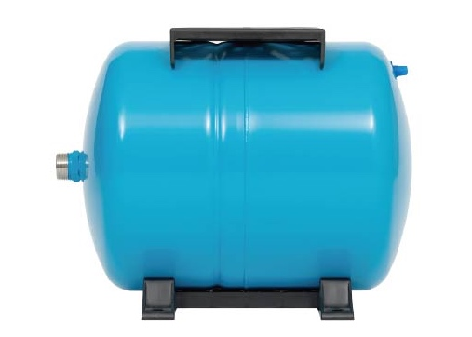
24 Liter / 6 Gallon Horizontal Water Pressure Tank
PRODUCT INFORMATION
Triple coated tough, appliance-like finish for extended life Heavy gauge steel construction for maximum durability Stainless steel water connector Factory pre-charged at 30 PSI Convenient air valve location for quick hook up No water to metal contact; rust-free operation Air Sealed Diaphragm. NSF certified butyl rubber diaphragm 100% Air Seal Certified to ANSI/NSF 61
Model Number |  | APT-24H
Customer SKU Number
 |  | FOB | Vaughan, ON
SPECIFICATIONS
Tank Orientation | Horizontal
Certified | NSF 61
Color/Finish | Blue
Discharge outlet size | 1 inch
Outlet Connection size | 1 inch
Tank Material | Steel
Tank Capacity | 24L/6Ga
Precharge PSI | 40
Maximum Working Pressure | 120 PSI
Diameter | 29cm/11.4in
Retail Box Dimensions
Inches |  | Cm
H | 13.6 | H | 34.6
W | 17.1 | W | 43.5
D | 11.0 | D | 30.0
Wt. (lb) | 11.9 | Wt. (kg) | 5.4
Product Dimensions
inches |  | cm
H | 12.8 | H | 32.6
W | 16.3 | W | 41.5
D | 11.4 | D | 29.0
Wt. (lb) | 10.6 | Wt. (kg) | 4.8

Slide 34
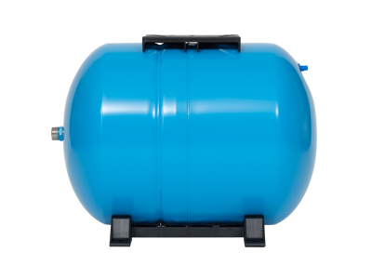
80 Liter / 20 Gallon Horizontal Water Pressure Tank
PRODUCT INFORMATION
Triple coated tough, appliance-like finish for extended life Heavy gauge steel construction for maximum durability Stainless steel water connector Factory pre-charged at 30 PSI Convenient air valve location for quick hook up No water to metal contact; rust-free operation Air Sealed Diaphragm. NSF certified butyl rubber diaphragm 100% Air Seal Certified to ANSI/NSF 61
Model Number |  | APT-80H
Customer SKU Number
 |  | FOB | Vaughan, ON
SPECIFICATIONS
Tank Orientation | Horizontal
Certified | NSF 61
Color/Finish | Blue
Discharge outlet size | 1 inch
Outlet Connection size | 1 inch
Tank Material | Steel
Tank Capacity | 80L/20Ga
Precharge PSI | 40
Maximum Working Pressure | 120 PSI
Diameter | 43.2cm/17in
Retail Box Dimensions
Inches |  | Cm
H | 19.2 | H | 48.8
W | 24.9 | W | 63.3
D | 17.5 | D | 44.5
Wt. (lb) | 29.8 | Wt. (kg) | 13.5
Product Dimensions
inches |  | cm
H | 18.5 | H | 46.9
W | 24.5 | W | 62.2
D | 17.0 | D | 43.2
Wt. (lb) | 26.5 | Wt. (kg) | 12.0

Slide 35
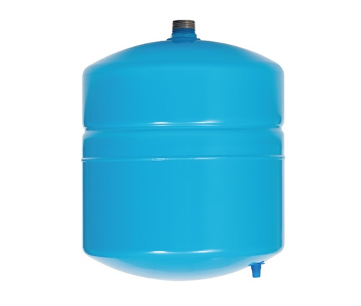
18 Liter / 4.5 Gallon Vertical Water Pressure Tank
PRODUCT INFORMATION
Triple coated tough, appliance-like finish for extended life Heavy gauge steel construction for maximum durability Stainless steel water connector Factory pre-charged at 30 PSI Convenient air valve location for quick hook up No water to metal contact; rust-free operation Air Sealed Diaphragm. NSF certified butyl rubber diaphragm 100% Air Seal Certified to ANSI/NSF 61
Model Number |  | APT-18
Customer SKU Number
 |  | FOB | Vaughan, ON
SPECIFICATIONS
Tank Orientation | Vertical
Certified | NSF 61
Color/Finish | Blue
Discharge outlet size | 1 inch
Outlet Connection size | 1 inch
Tank Material | Steel
Tank Capacity
Precharge PSI | 40
Maximum Working Pressure | 120 PSI
Diameter | 28cm/11.0in
Retail Box Dimensions
Inches |  | Cm
H | 15.2 | H | 38.5
W | 11.4 | W | 29.0
D | 11.4 | D | 29.0
Wt. (lb) | 8.16 | Wt. (kg) | 3.7
Product Dimensions
inches |  | cm
H | 14.3 | H | 36.4
W | 11 | W | 28.0
D | 11 | D | 28.0
Wt. (lb) | 7.28 | Wt. (kg) | 3.3

Slide 36
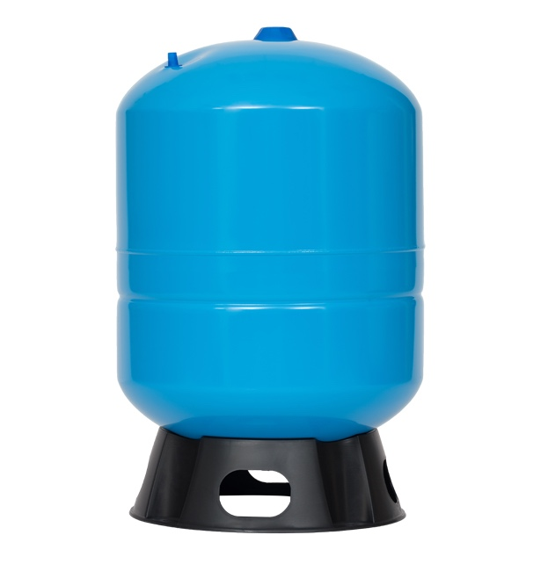
80 Liter / 20 Gallon Vertical Water Pressure Tank
PRODUCT INFORMATION
Triple coated tough, appliance-like finish for extended life Heavy gauge steel construction for maximum durability Stainless steel water connector Factory pre-charged at 30 PSI Convenient air valve location for quick hook up No water to metal contact; rust-free operation Air Sealed Diaphragm. NSF certified butyl rubber diaphragm 100% Air Seal Certified to ANSI/NSF 61
Model Number |  | APT-80
Customer SKU Number
 |  | FOB | Vaughan, ON
SPECIFICATIONS
Tank Orientation | Vertical
Certified | NSF 61
Color/Finish | Blue
Discharge outlet size | 1 inch
Outlet Connection size | 1 inch
Tank Material | Steel
Tank Capacity
Precharge PSI | 40
Maximum Working Pressure | 120 PSI
Diameter | 43.2cm/17in
Retail Box Dimensions
Inches |  | Cm
H | 28.0 | H | 71.0
W | 17.3 | W | 44.0
D | 17.3 | D | 44.0
Wt. (lb) | 30.9 | Wt. (kg) | 14.0
Product Dimensions
inches |  | cm
H | 27.3 | H | 60.3
W | 17 | W | 43.2
D | 17 | D | 43.2
Wt. (lb) | 26.7 | Wt. (kg) | 12.1

Slide 37
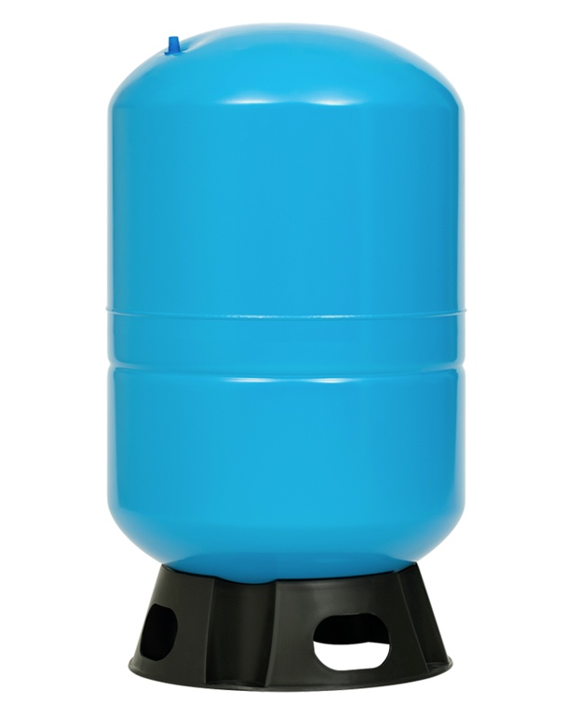
100 Liter / 28 Gallon Vertical Water Pressure Tank
PRODUCT INFORMATION
Triple coated tough, appliance-like finish for extended life Heavy gauge steel construction for maximum durability Stainless steel water connector Factory pre-charged at 30 PSI Convenient air valve location for quick hook up No water to metal contact; rust-free operation Air Sealed Diaphragm. NSF certified butyl rubber diaphragm 100% Air Seal Certified to ANSI/NSF 61
Model Number |  | APT-100
Customer SKU Number
 |  | FOB | Vaughan, ON
SPECIFICATIONS
Tank Orientation | Vertical
Certified | NSF 61
Color/Finish | Blue
Discharge outlet size | 1 inch
Outlet Connection size | 1 inch
Tank Material | Steel
Tank Capacity
Precharge PSI | 40
Maximum Working Pressure | 120 PSI
Diameter | 43cm/16.9in
Retail Box Dimensions
Inches |  | Cm
H | 31.0 | H | 78.8
W | 17.3 | W | 44.0
D | 17.3 | D | 44.0
Wt. (lb) | 33.0 | Wt. (kg) | 15.2
Product Dimensions
inches |  | cm
H | 30.1 | H | 76.5
W | 16.9 | W | 43.0
D | 16.9 | D | 43.0
Wt. (lb) | 29.3 | Wt. (kg) | 13.3

Slide 38
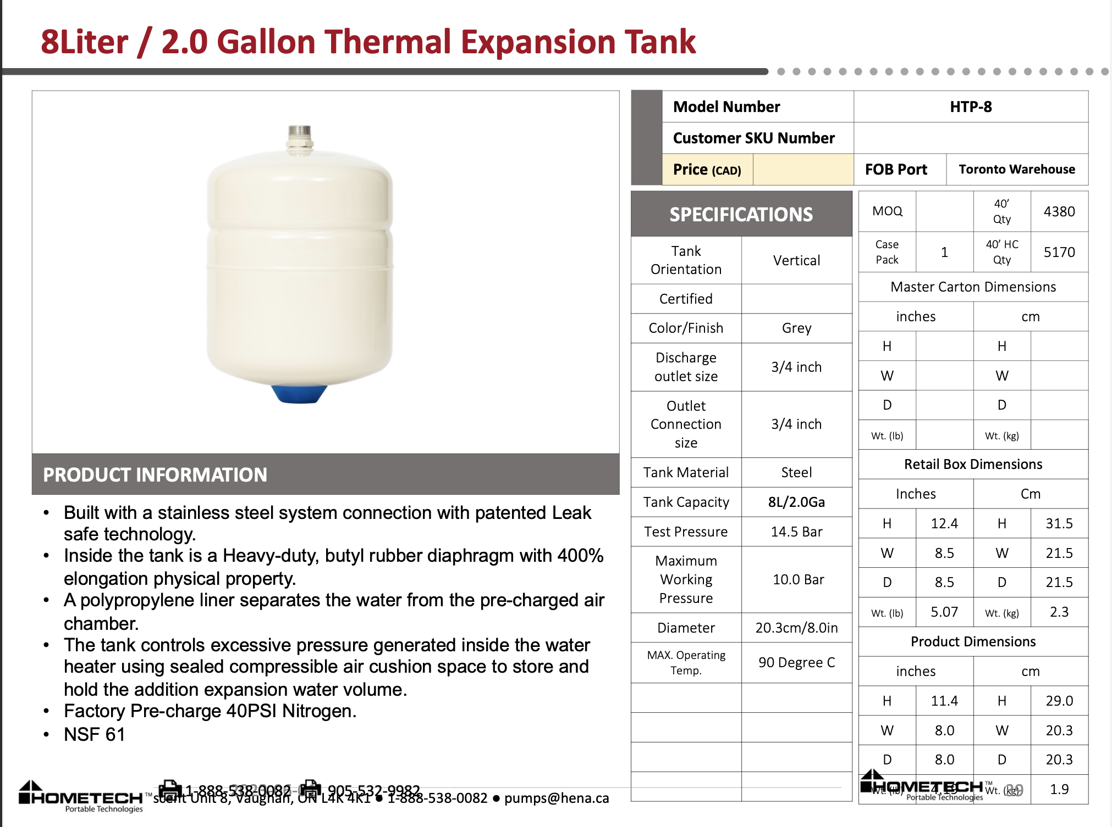
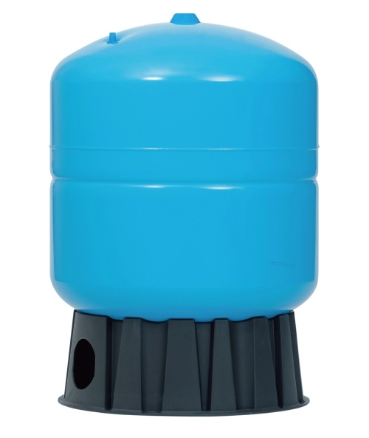
130 Liter / 34 Gallon Vertical Water Pressure Tank
PRODUCT INFORMATION
Triple coated tough, appliance-like finish for extended life Heavy gauge steel construction for maximum durability Stainless steel water connector Factory pre-charged at 30 PSI Convenient air valve location for quick hook up No water to metal contact; rust-free operation Air Sealed Diaphragm. NSF certified butyl rubber diaphragm 100% Air Seal Certified to ANSI/NSF 61
Model Number |  | APT-130
Customer SKU Number
 |  | FOB | Vaughan, ON
SPECIFICATIONS
Tank Orientation | Vertical
Certified | NSF 61
Color/Finish | Blue
Discharge outlet size | 1 1/4 inch
Outlet Connection size | 1 inch
Tank Material | Steel
Tank Capacity
Precharge PSI | 40
Maximum Working Pressure | 120 PSI
Diameter | 55cm/21.7in
Retail Box Dimensions
Inches |  | Cm
H | 31.9 | H | 80.5
W | 22.1 | W | 56.0
D | 22.1 | D | 56.0
Wt. (lb) | 54.1 | Wt. (kg) | 24.5
Product Dimensions
inches |  | cm
H | 30.9 | H | 78.5
W | 21.7 | W | 55.0
D | 21.7 | D | 55.0
Wt. (lb) | 47.4 | Wt. (kg) | 21.5

Slide 39
